Slide 1


Slide 2




D0n’t D0 ill3gal Sh1t !

Slide 3
Announcements
CTF Club
Games Night (11th Nov)
Hack The Box University CTF Competition
If you would like to take part let a committee member know and we shall add you to the channel for the event
Takes place 13th 1300 - 15th 2200 Dec
Christmas Meal (28th Nov deadline for ticket purchase)

Slide 4
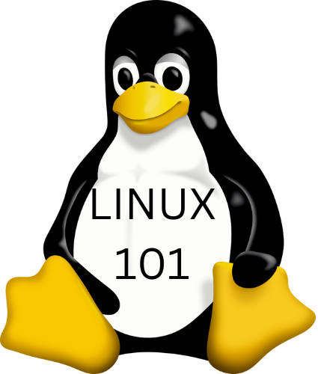
Tux will find you!

Slide 5

Notes:
Firebug student discount is all week and not just when we go out as a society

Slide 6
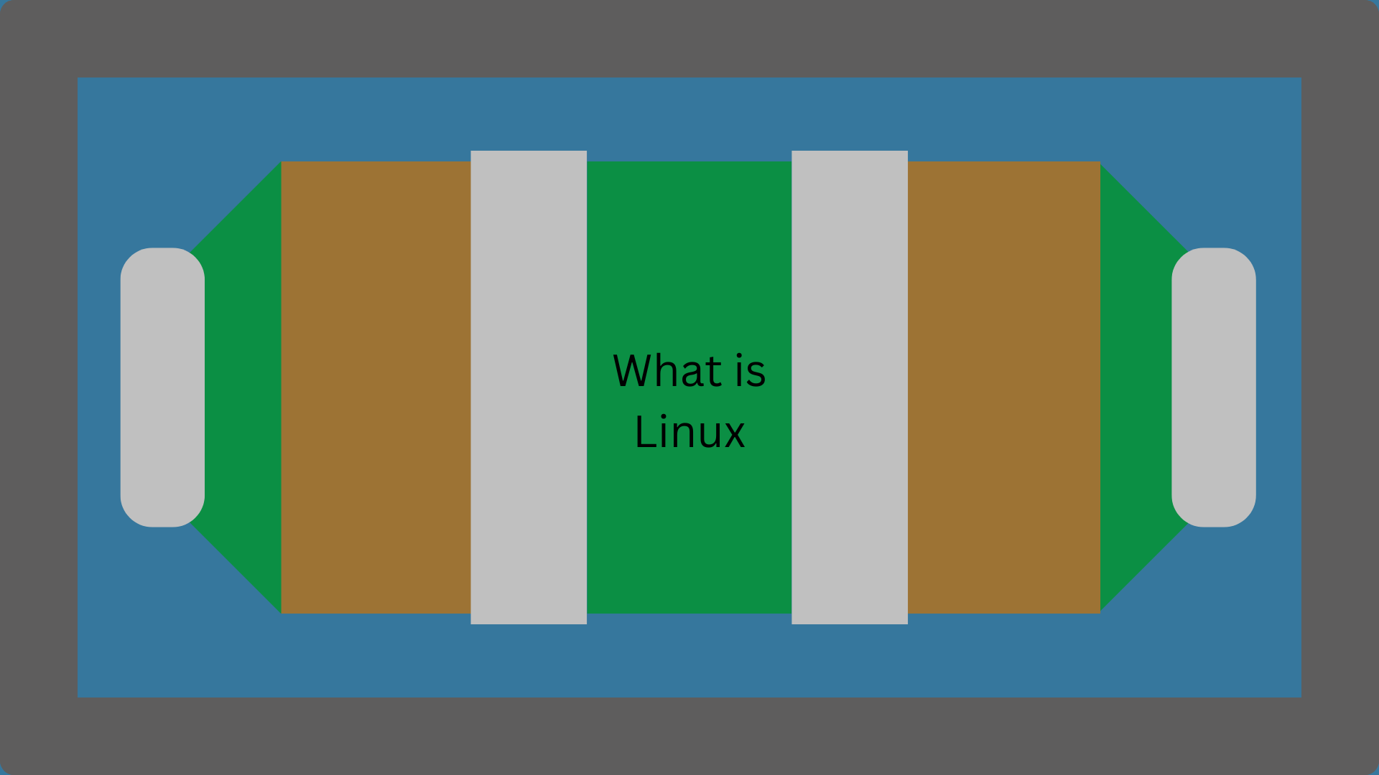

Slide 7
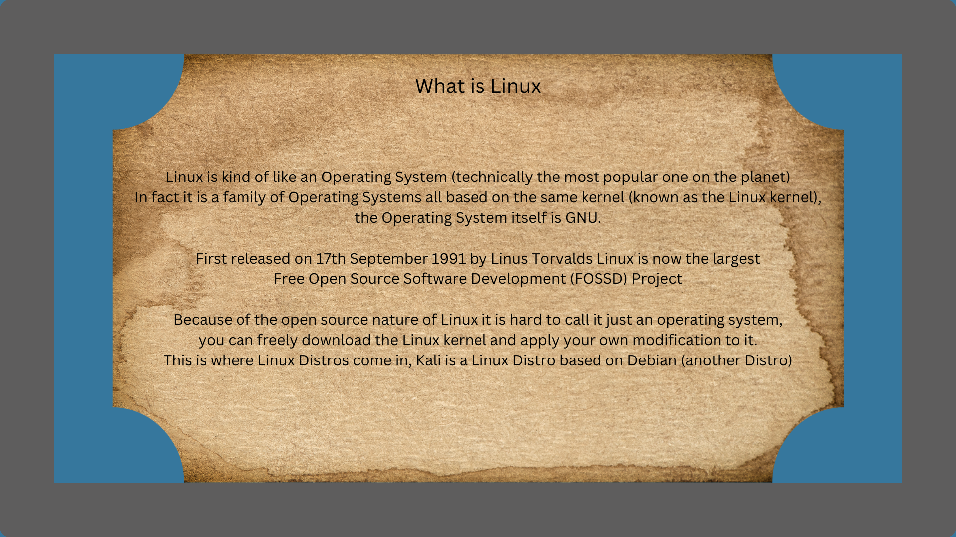

Slide 8
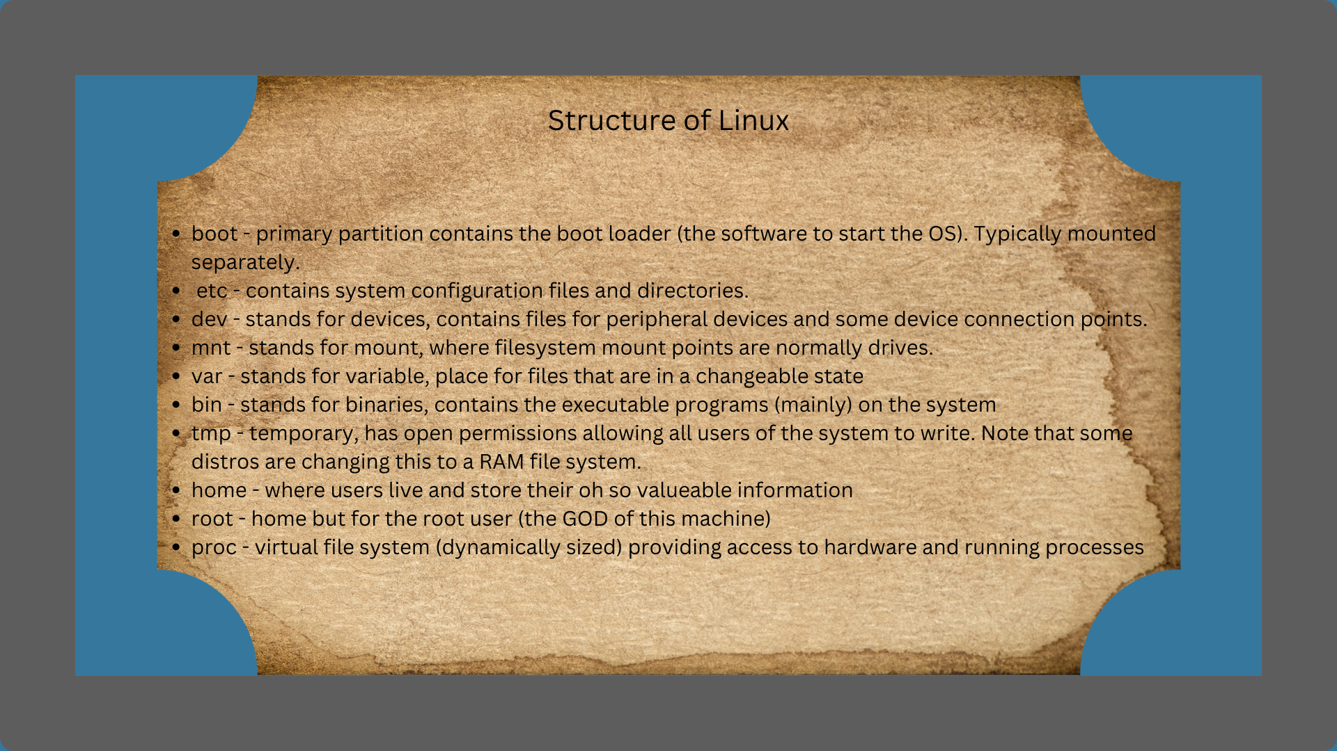

Slide 9
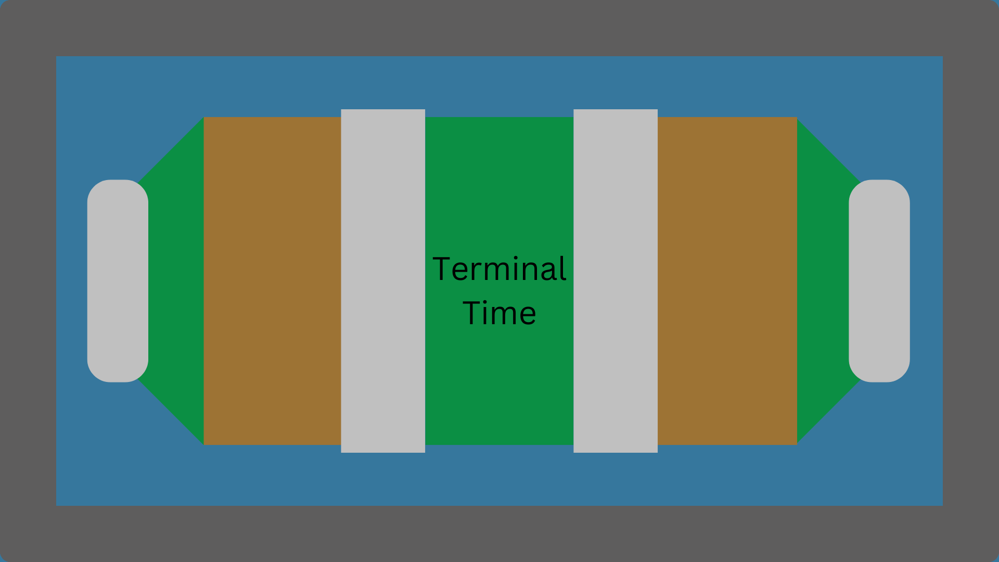

Slide 10
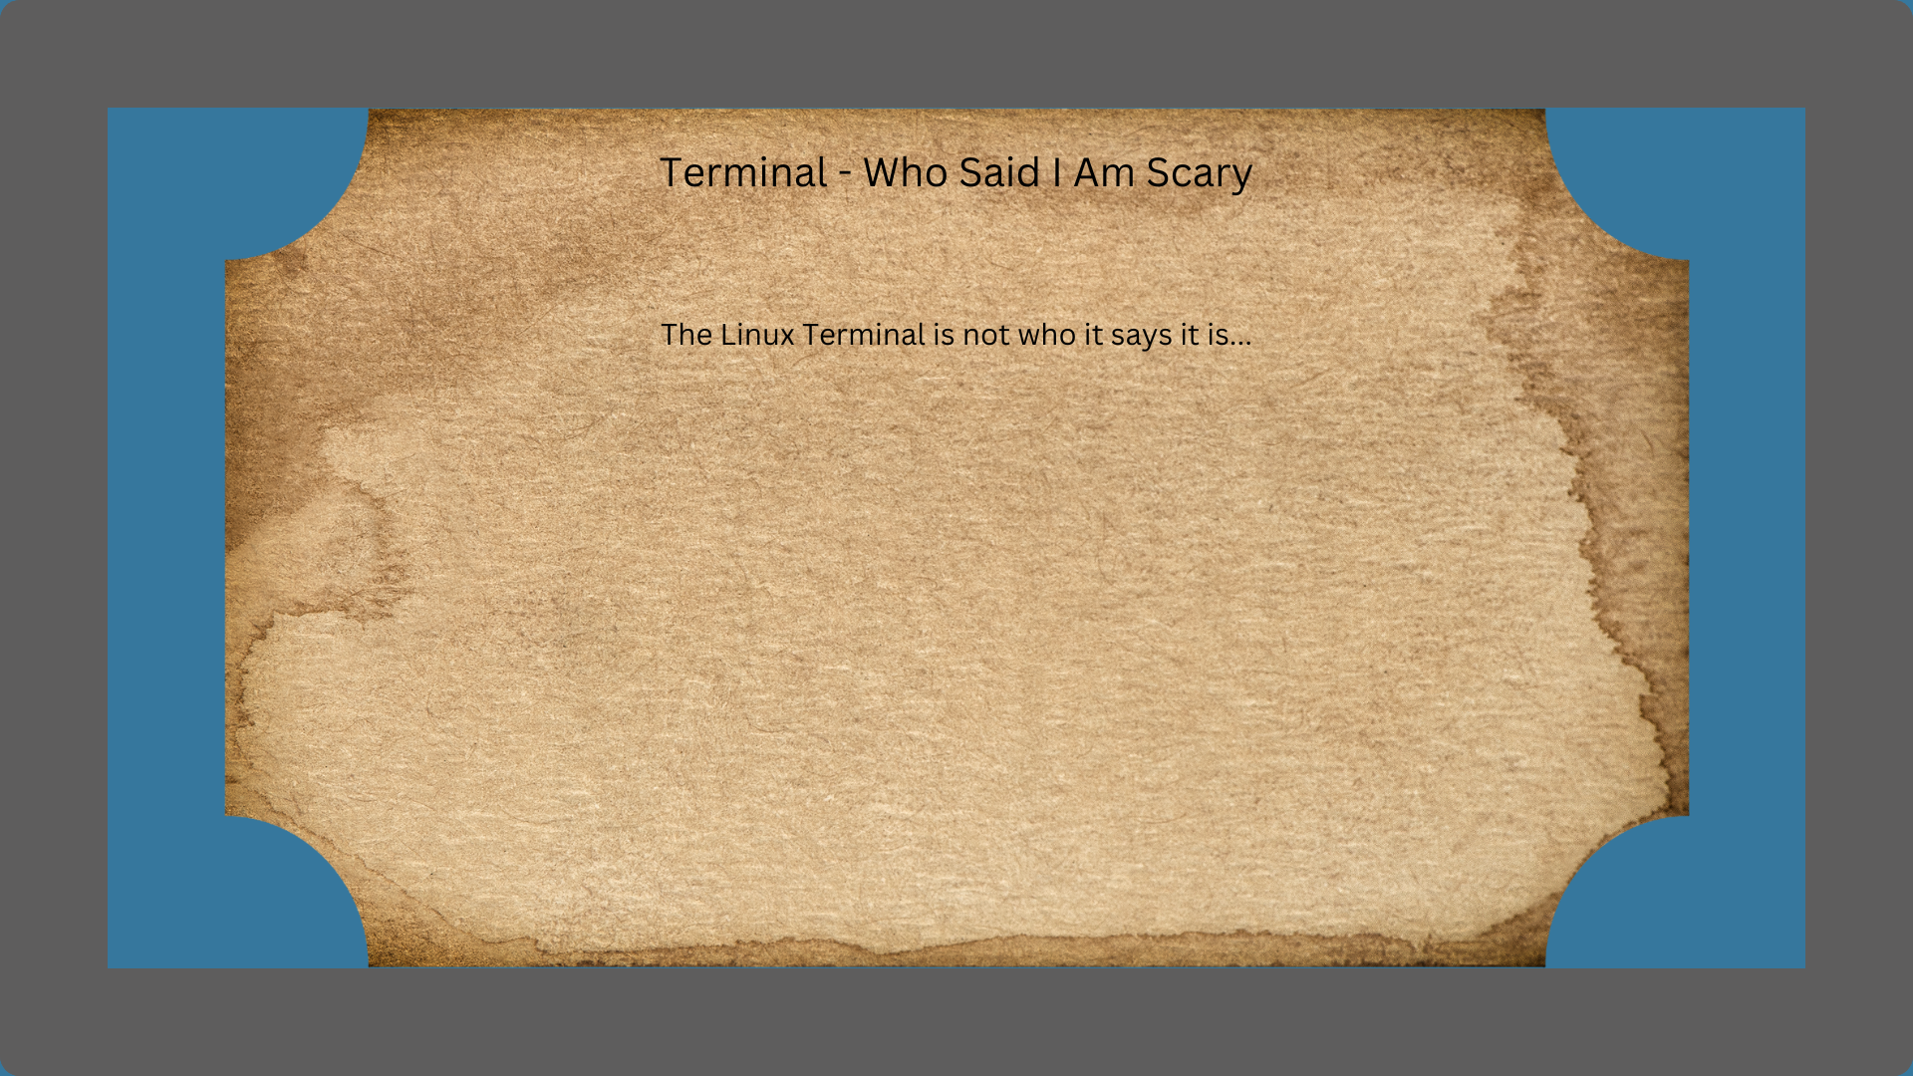
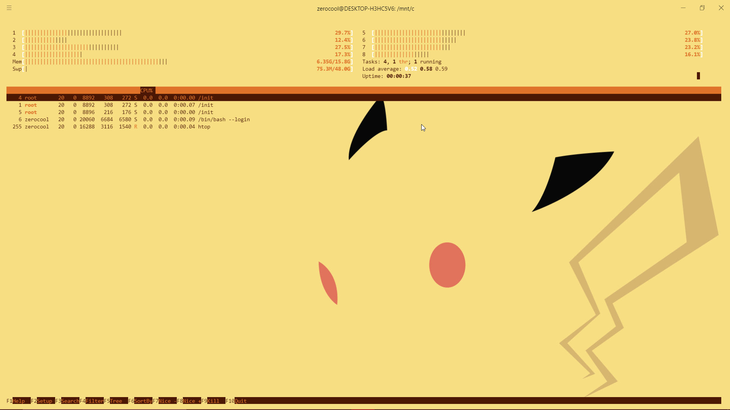
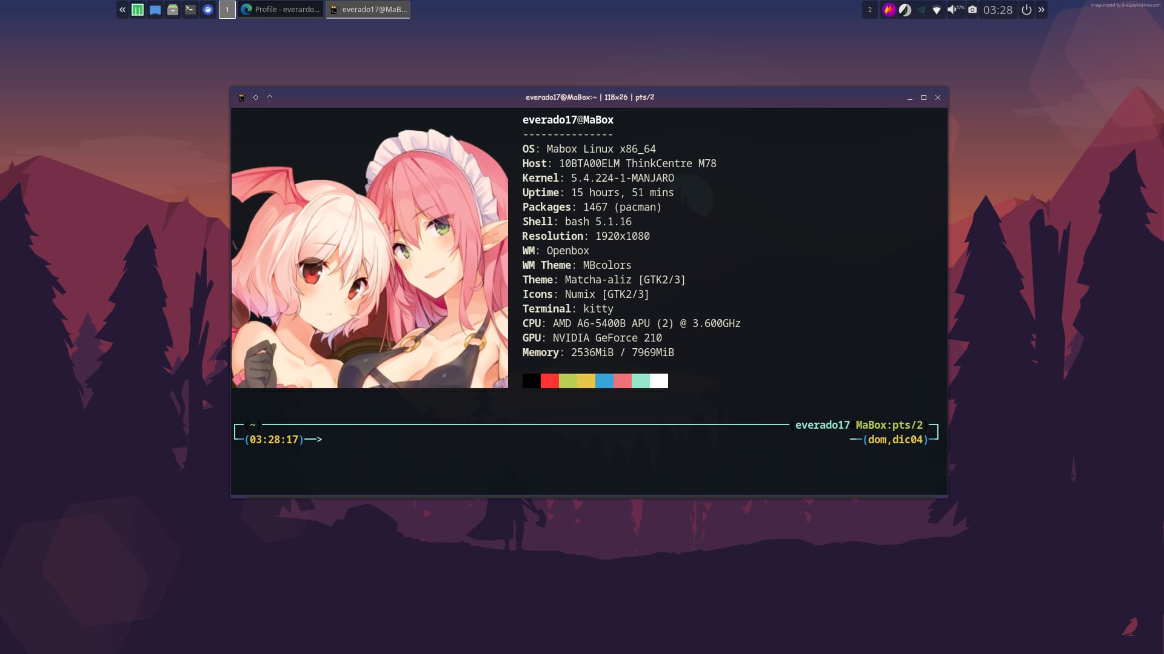
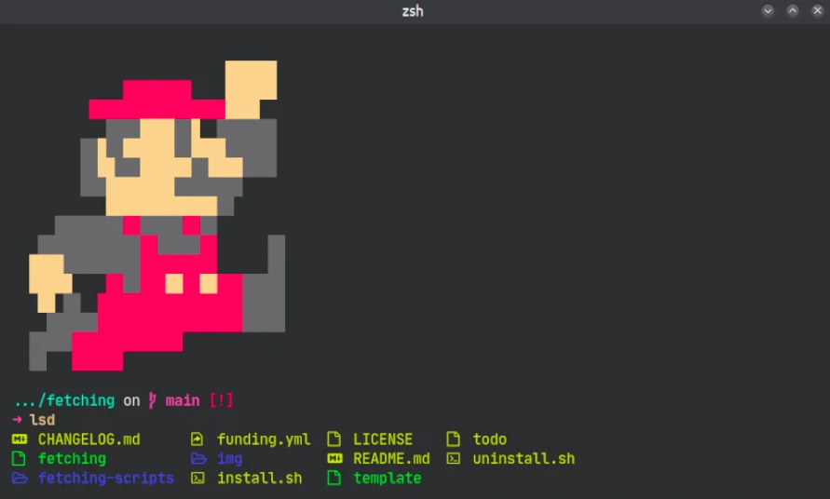
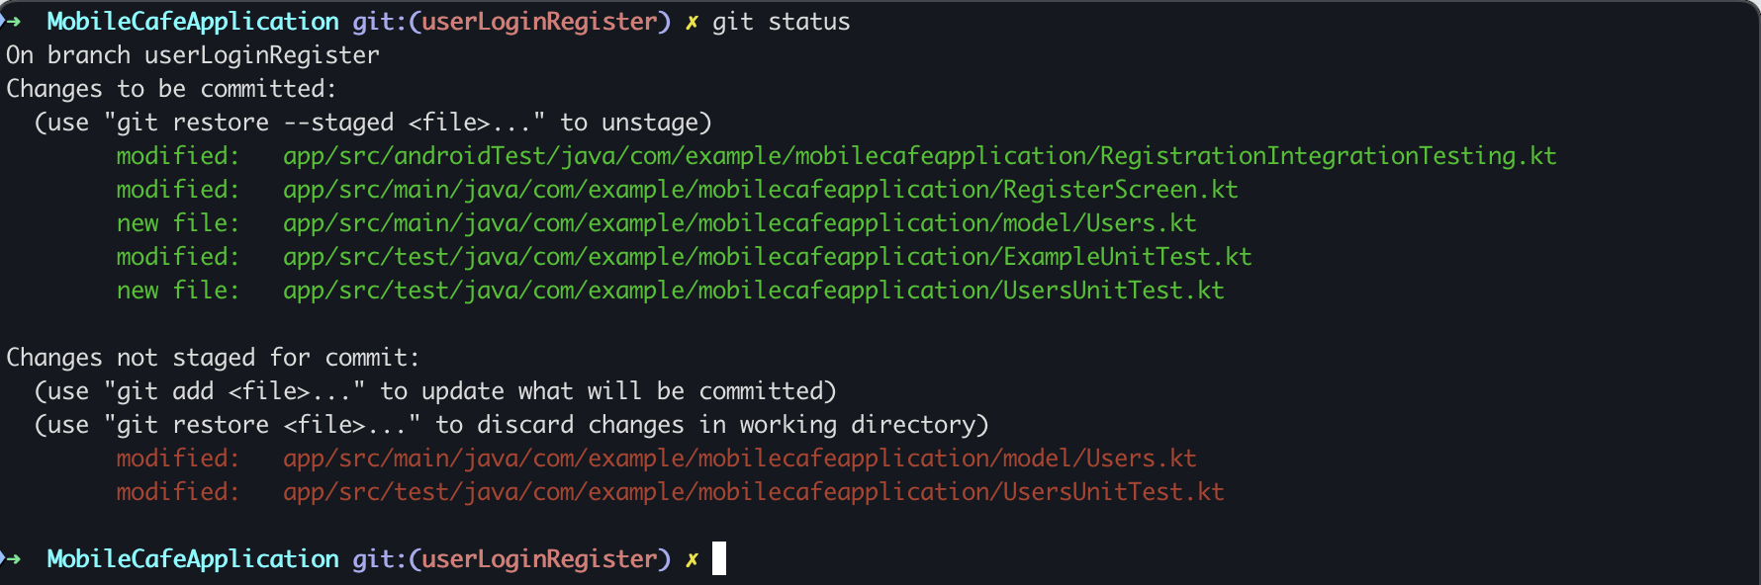
Notes:
Terminal - who said I am scary
The linux terminal you are all used to using is not really the terminal, instead it is an emulated version within the GUI that the distro is running. It allows you to complete all the tasks that a standard terminal would but with some nice quality of life features. Rather than being stuck to a single terminal instance you can create multiple that are completely independent of each other if you want them to be.
Unlike a serial connection to the machine which would only have a single terminal instance with you having to put operations in the background if you wanted to do something else.
Termainls are also infinitely customisable, instead of using something like bash you can swap it for something like ZSH (used by most Mac terminals, https://ohmyz.sh/) or fish (https://fishshell.com/).

Slide 11
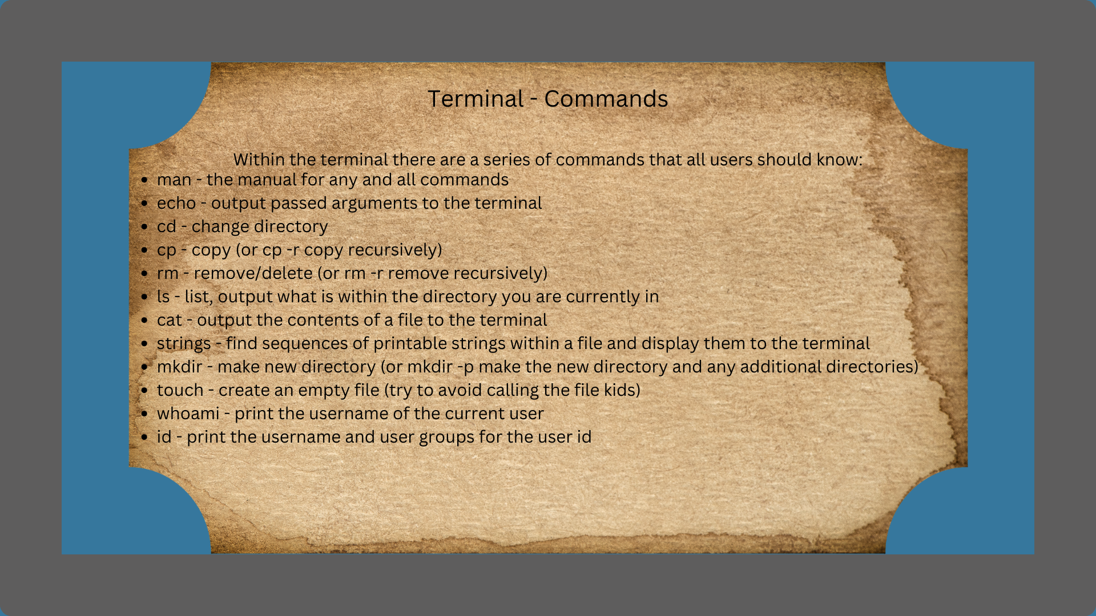

Slide 12
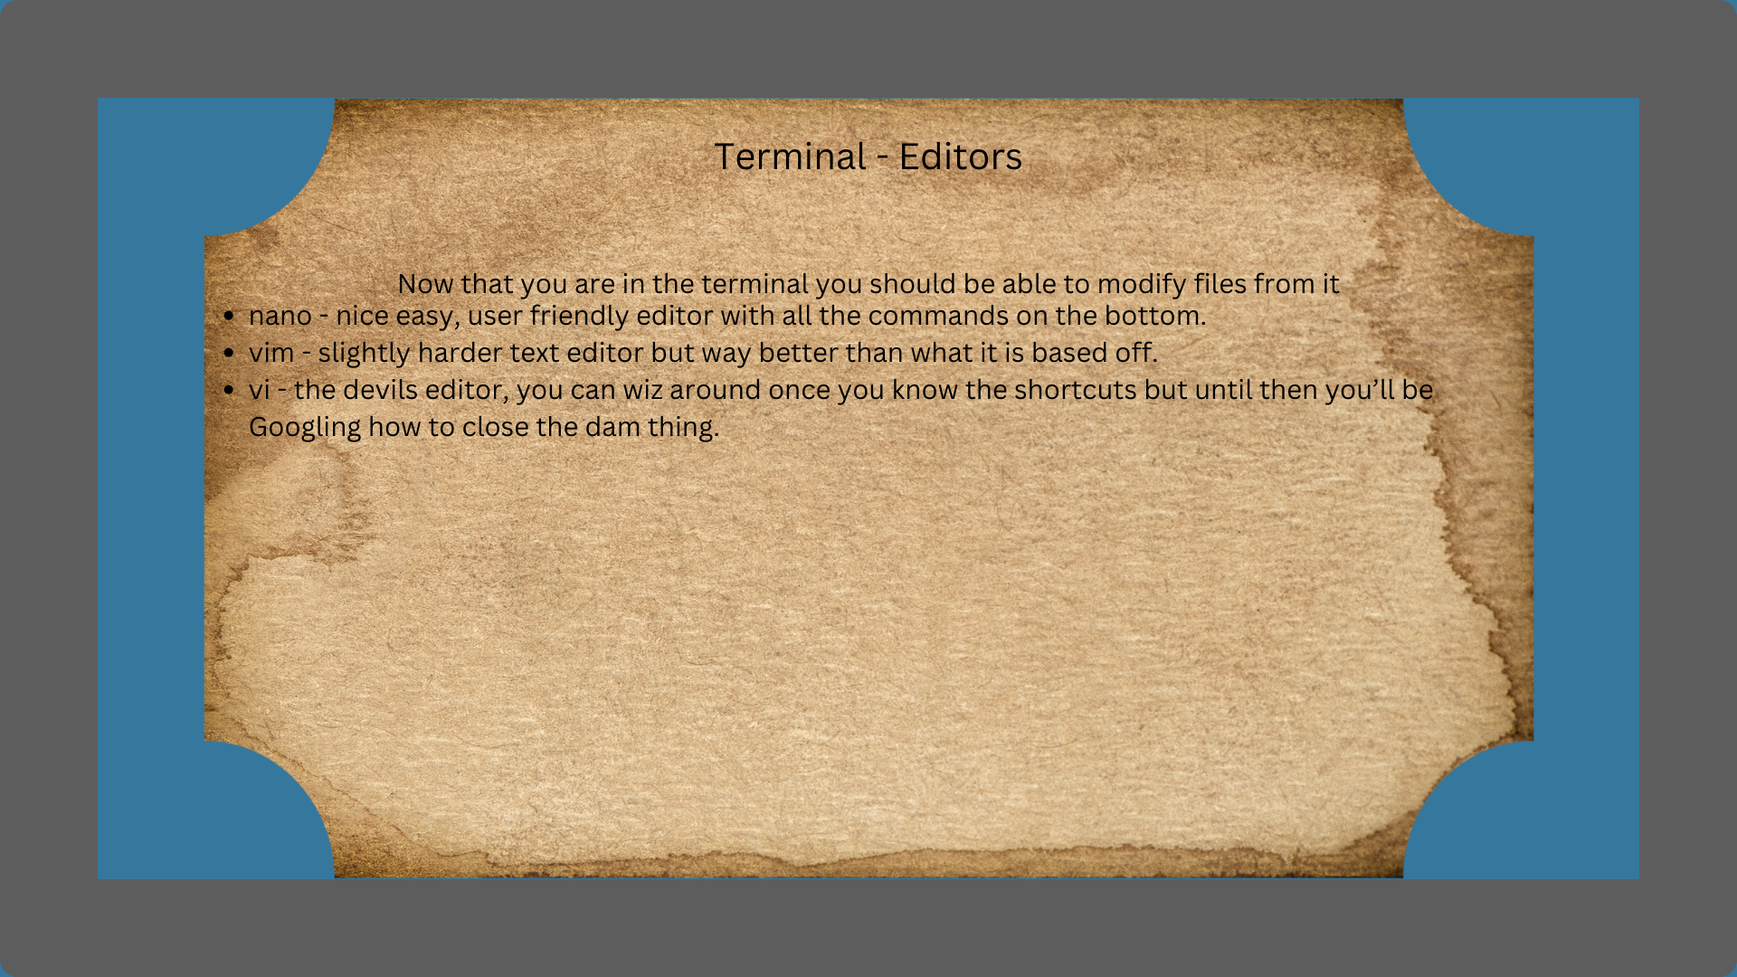
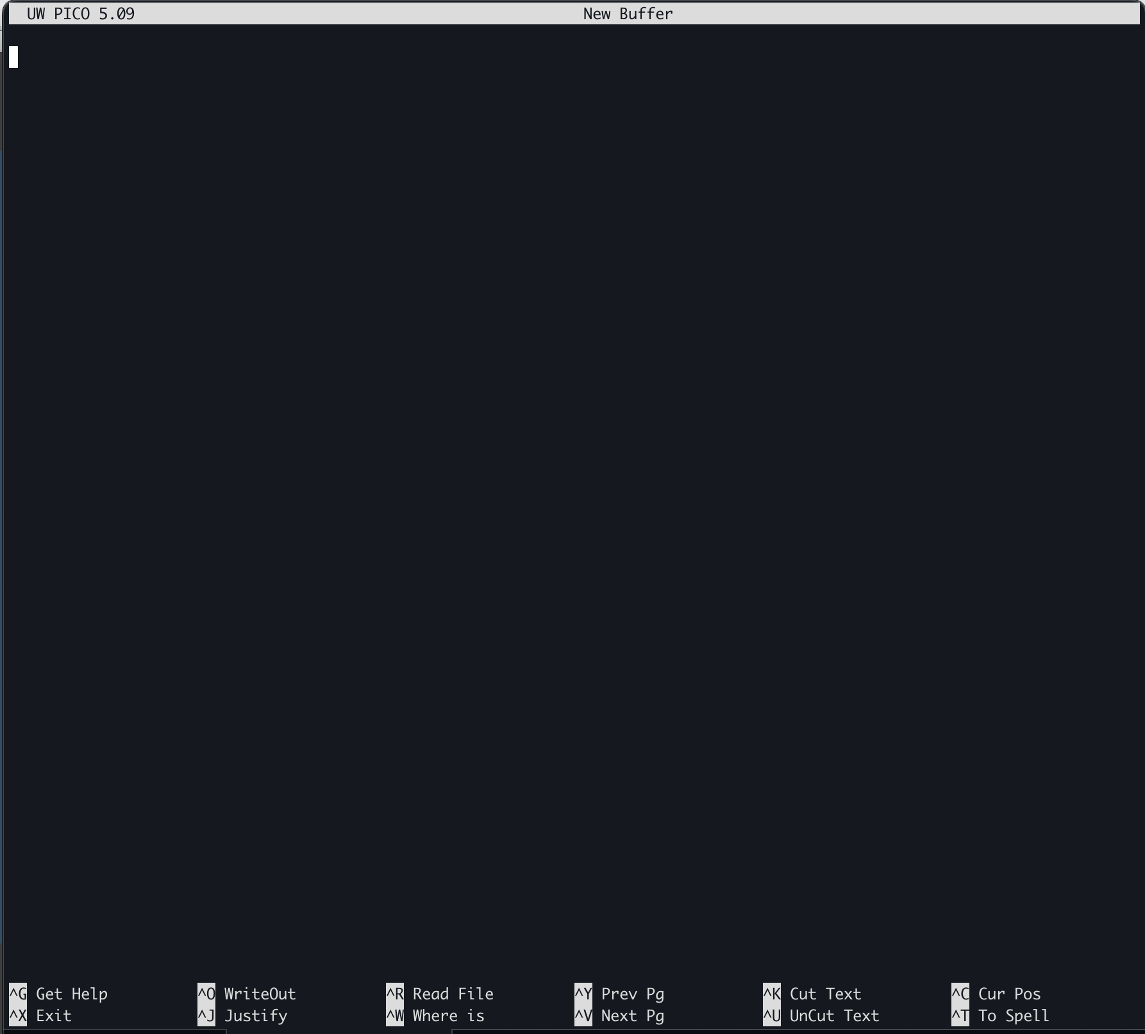
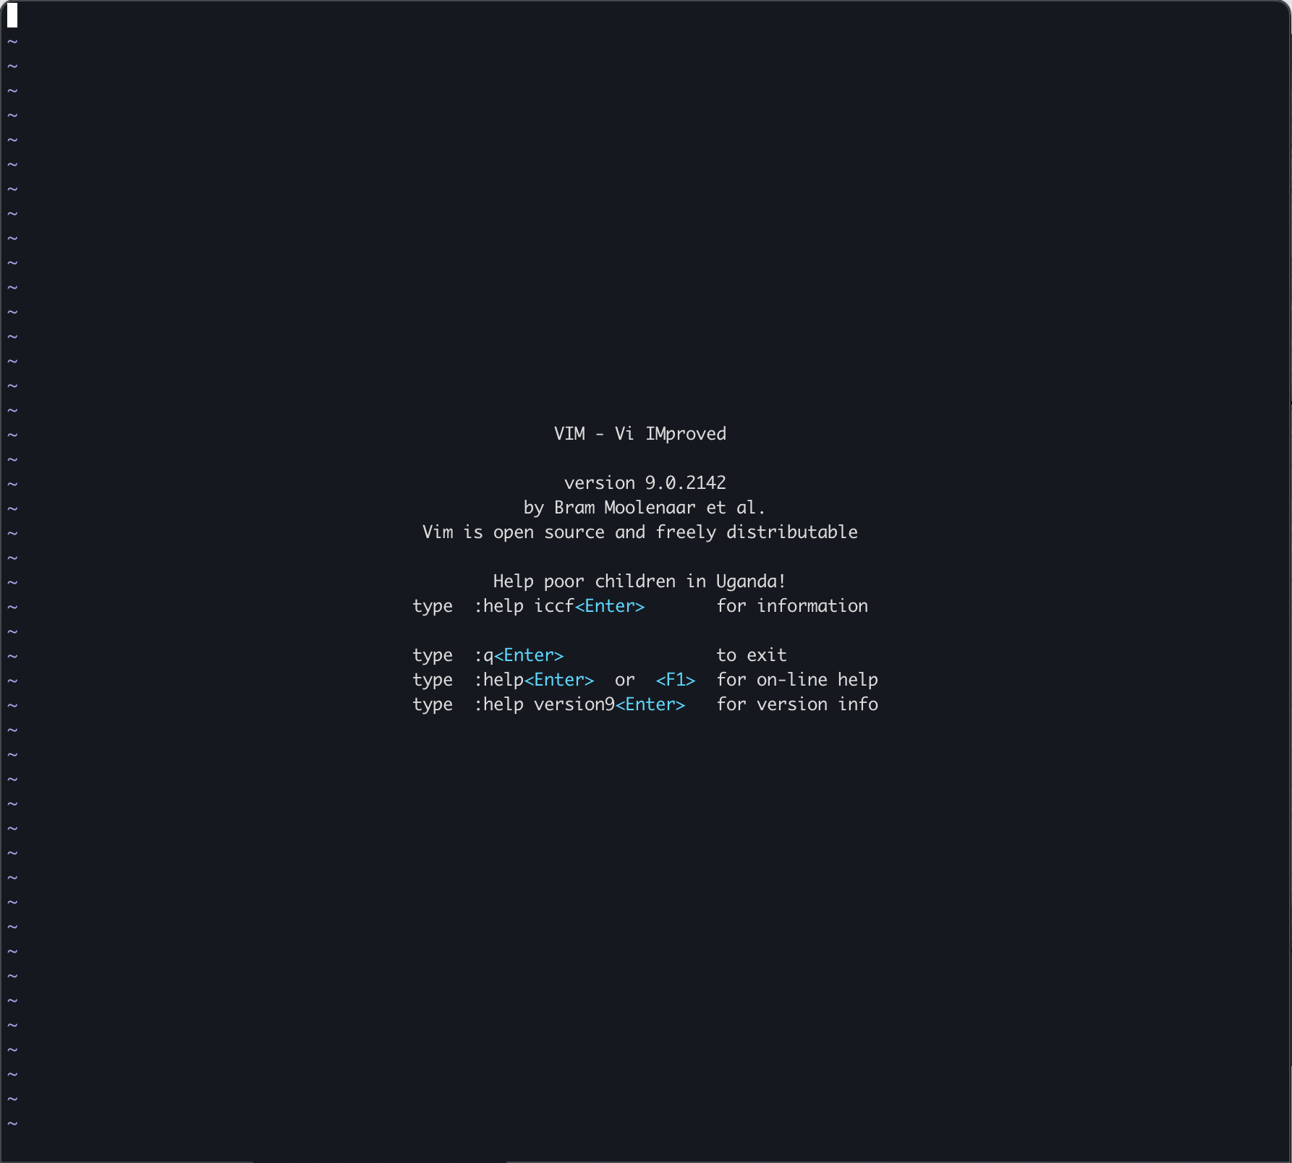

Slide 13
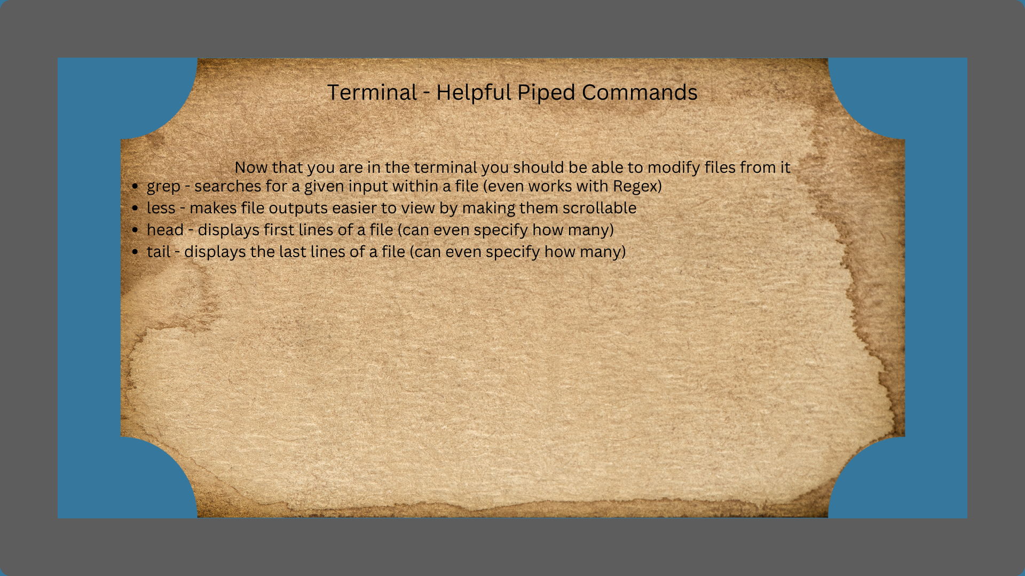
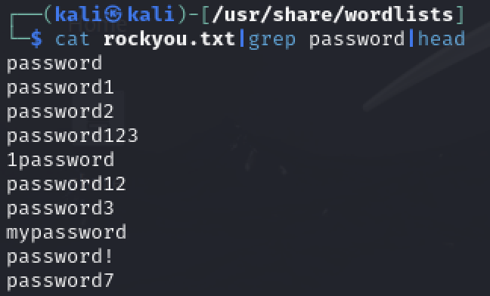
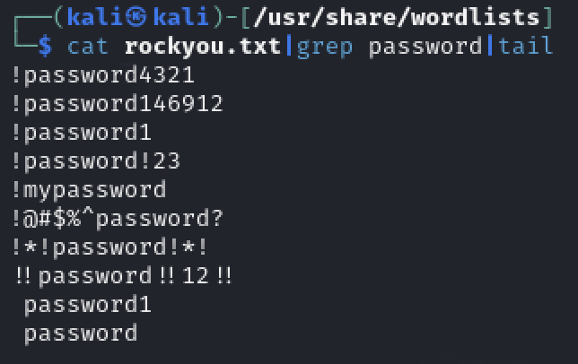

Slide 14
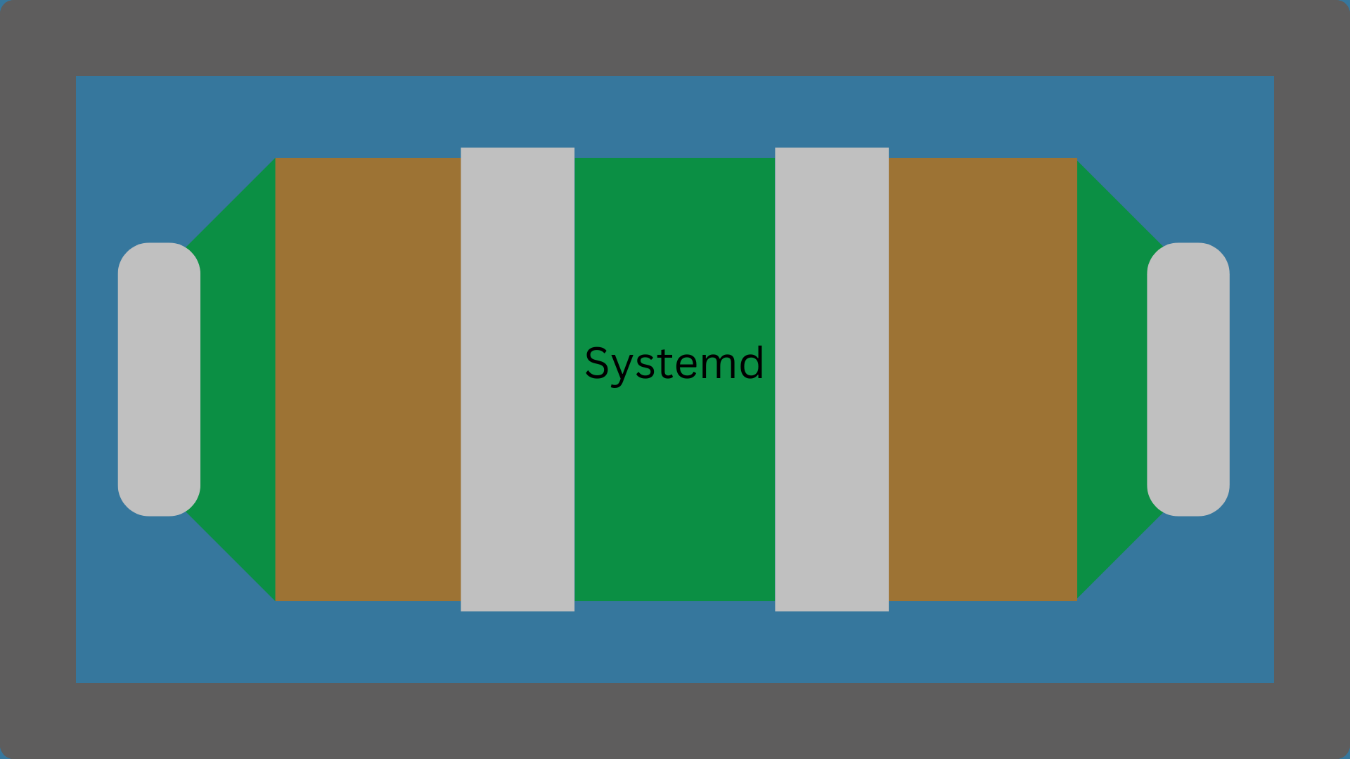

Slide 15
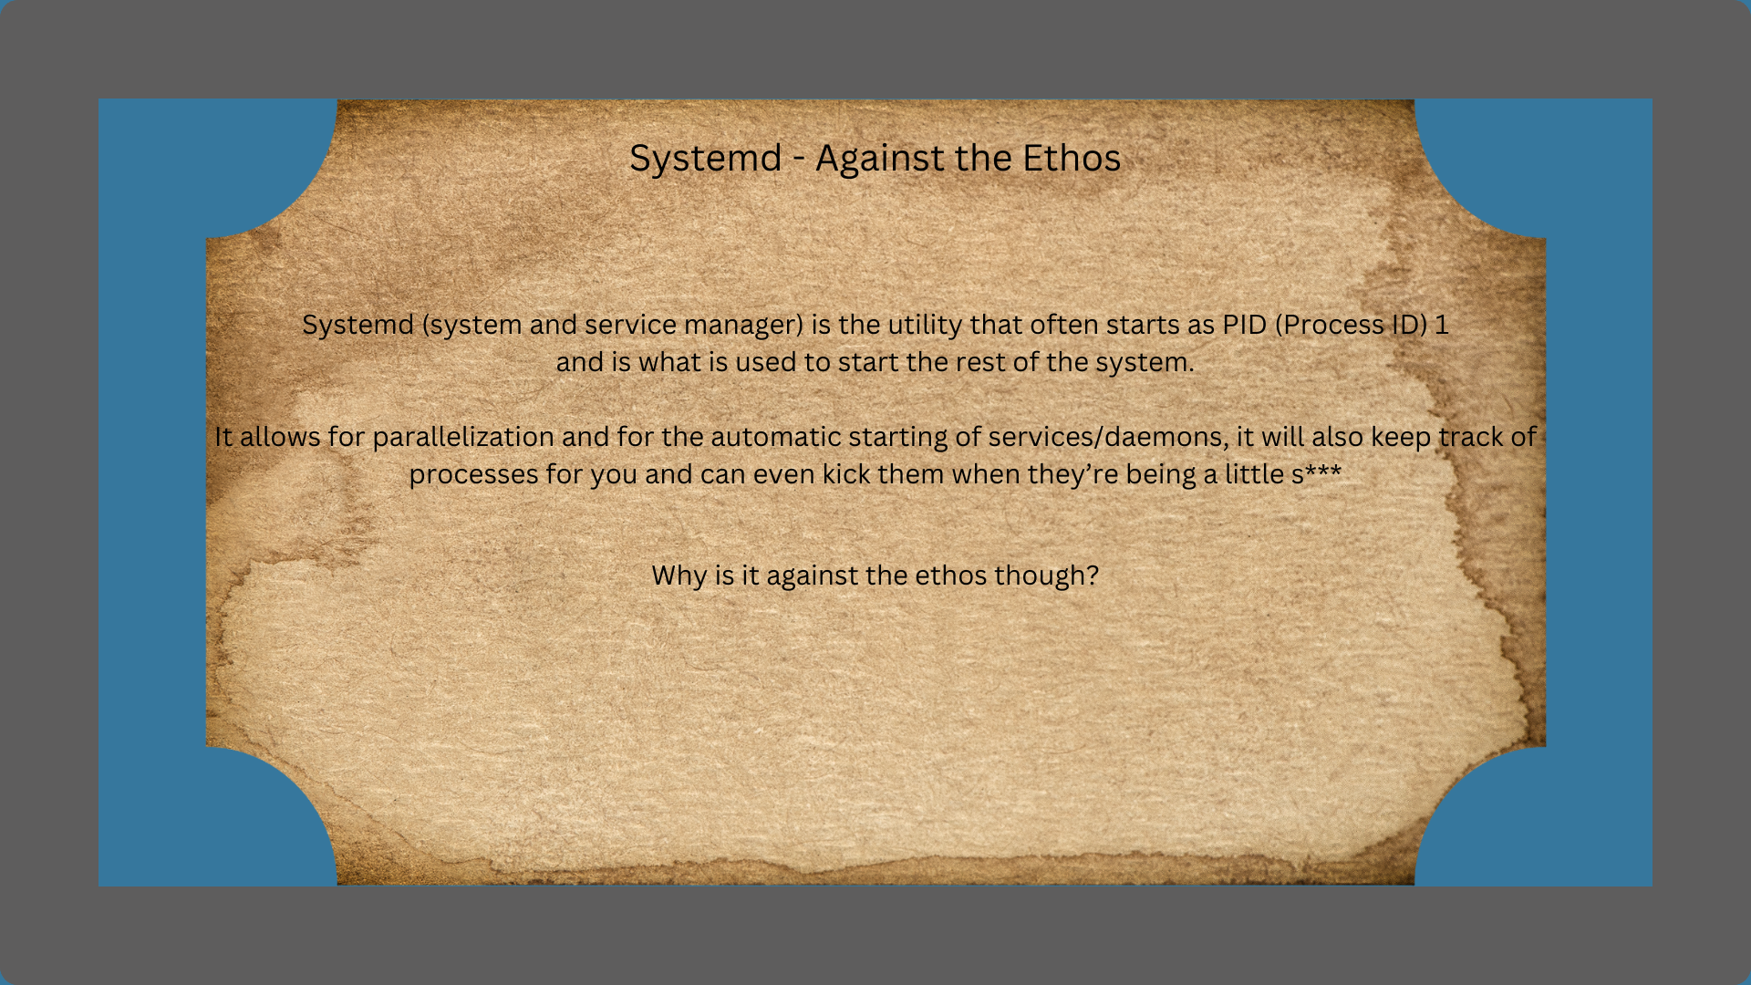
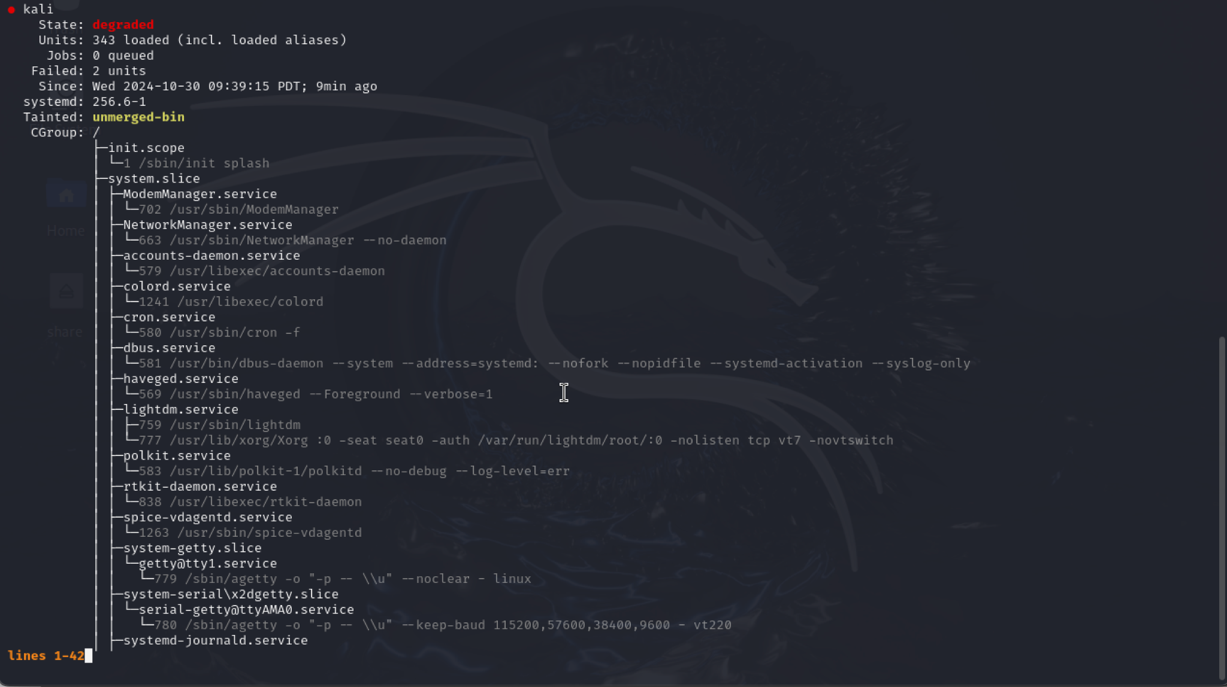

Slide 16
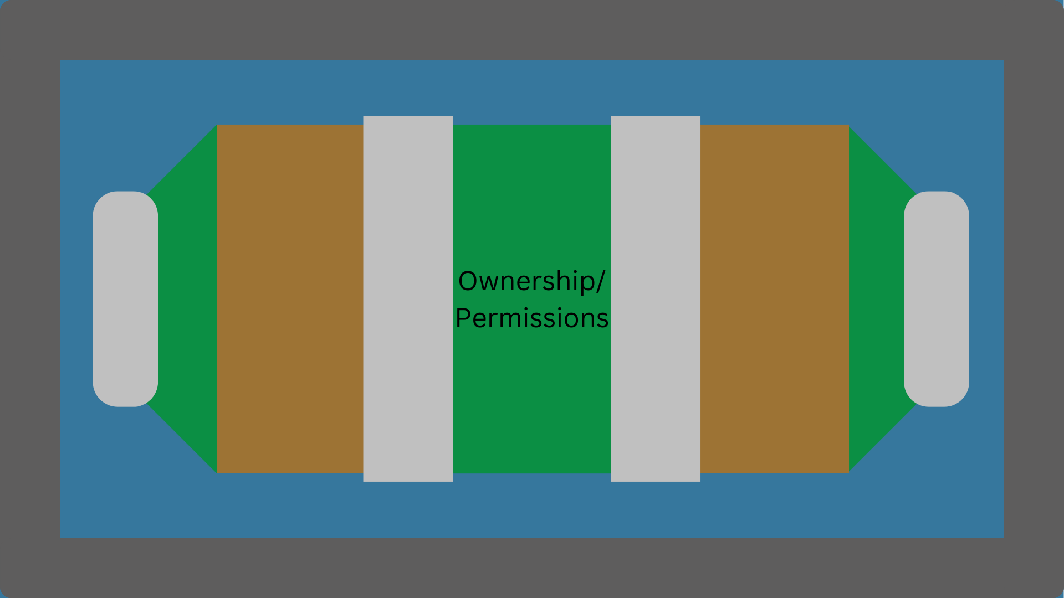

Slide 17
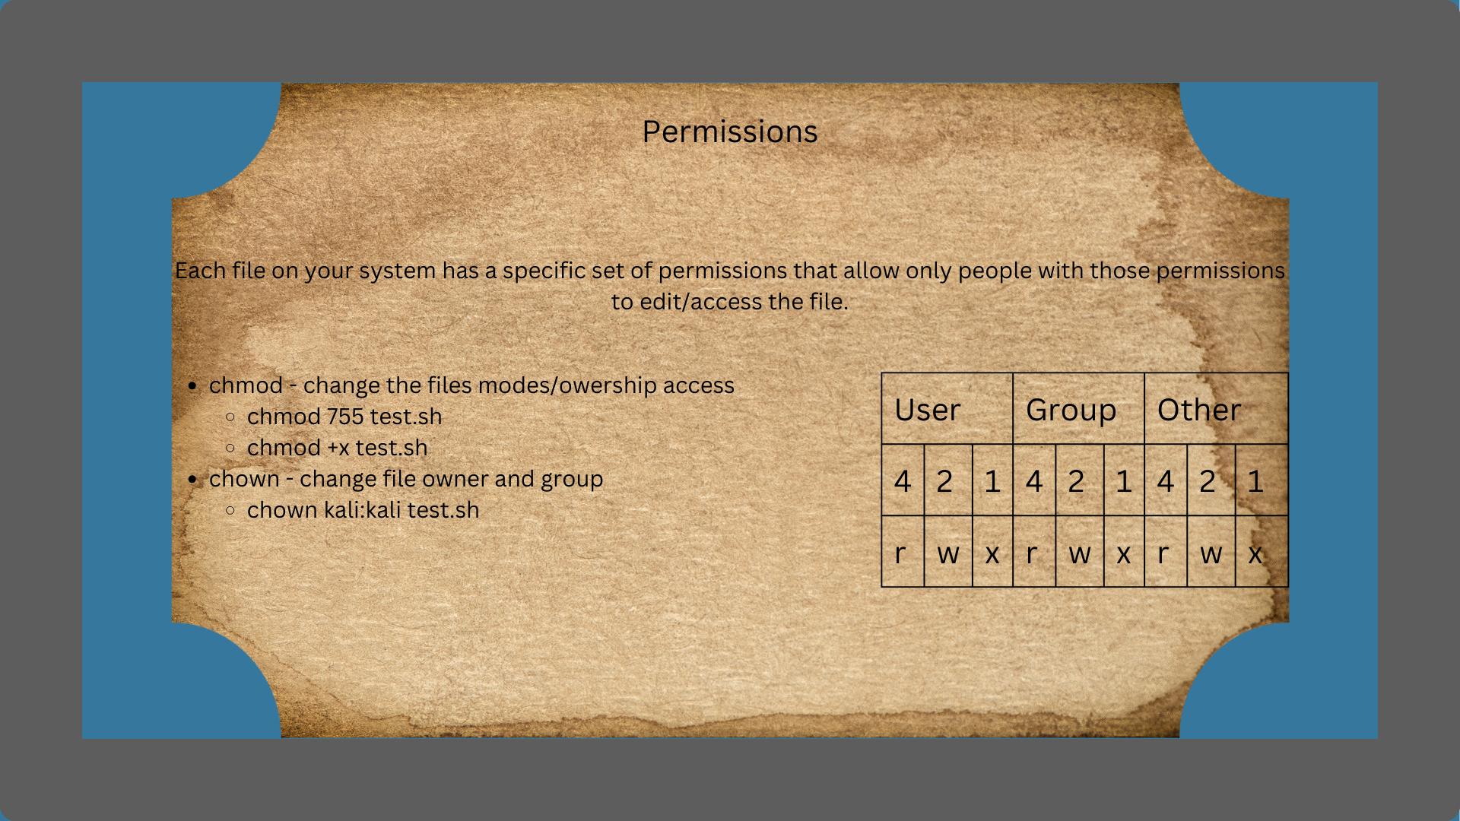
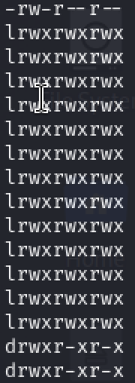

Slide 18
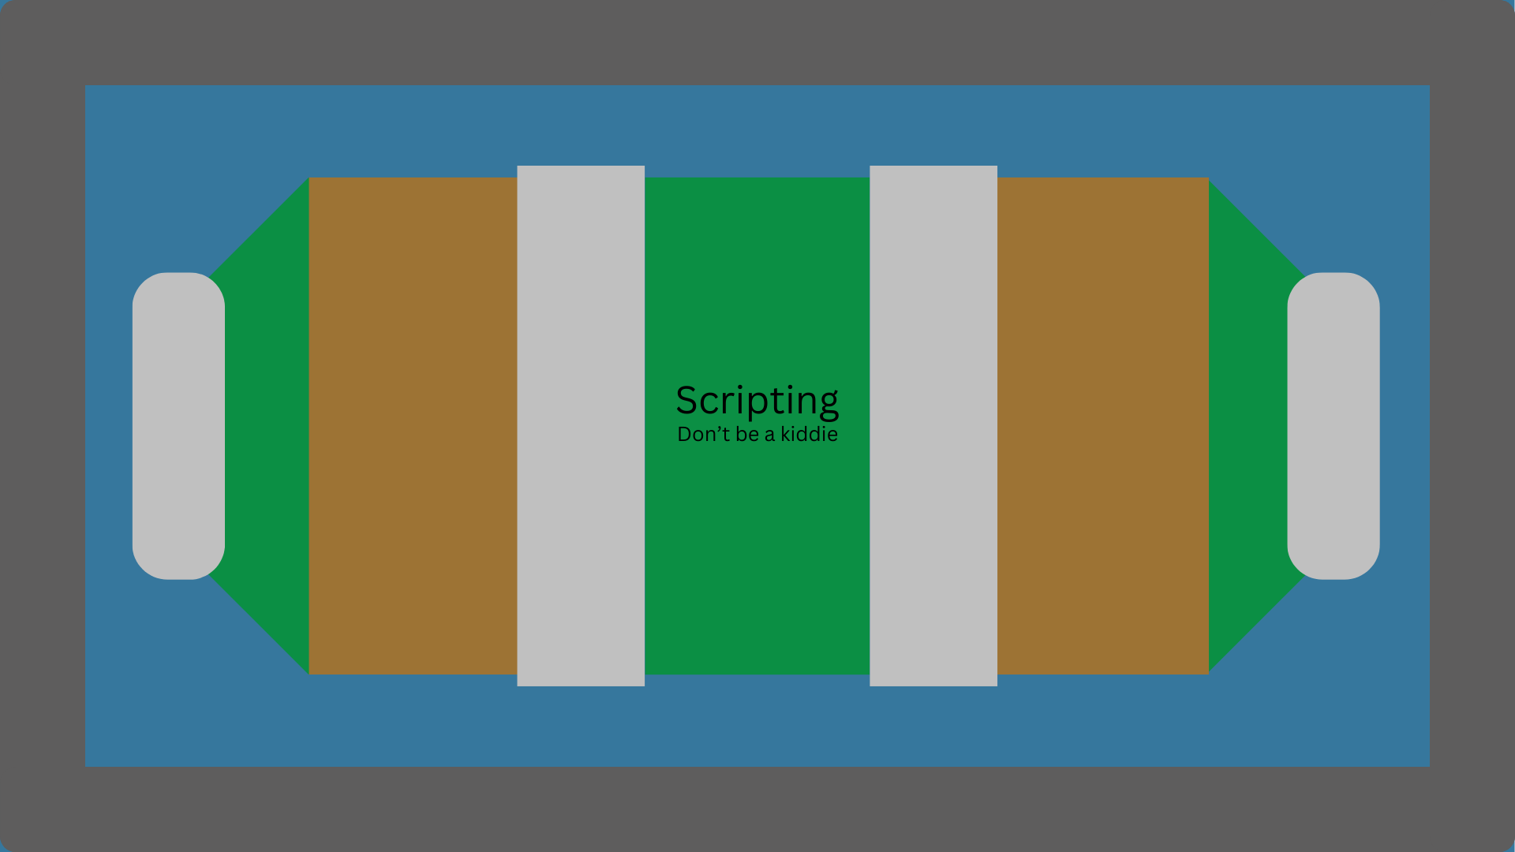

Slide 19
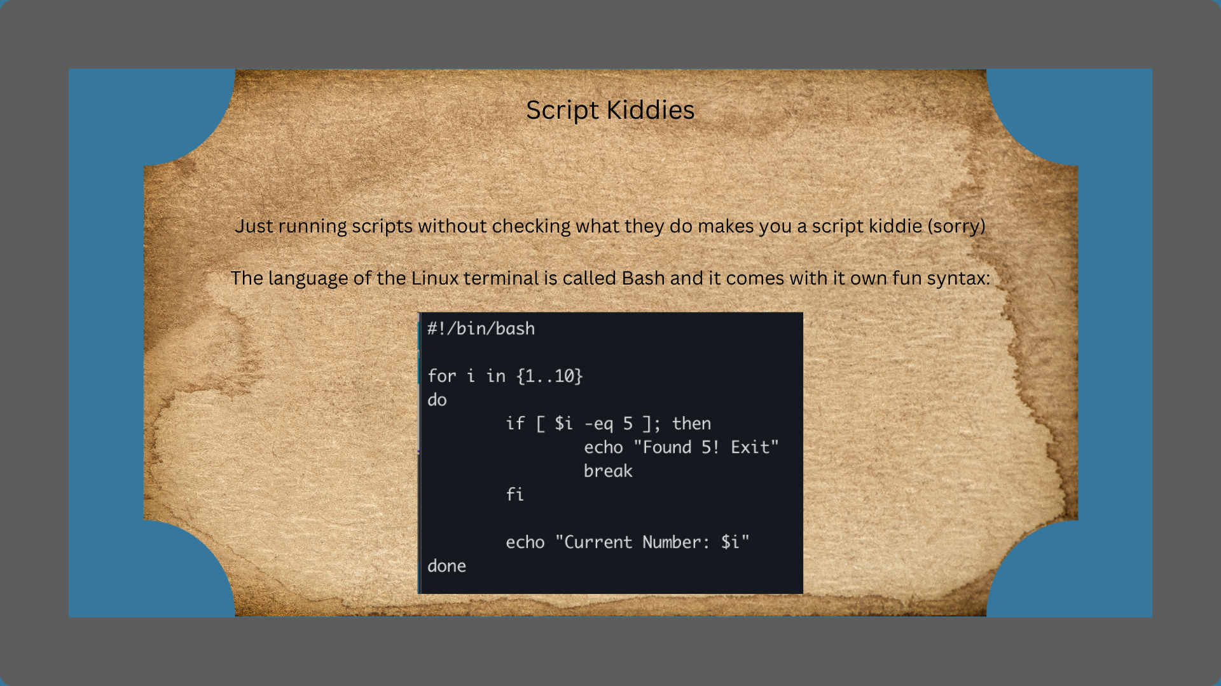
Comparison of the variable i against the digit 5
Tells the terminal what to run the script with. Without this you can still run the script but will need to specify how
Prints a string to terminal
Ends if statement
Ends for loop

Slide 20
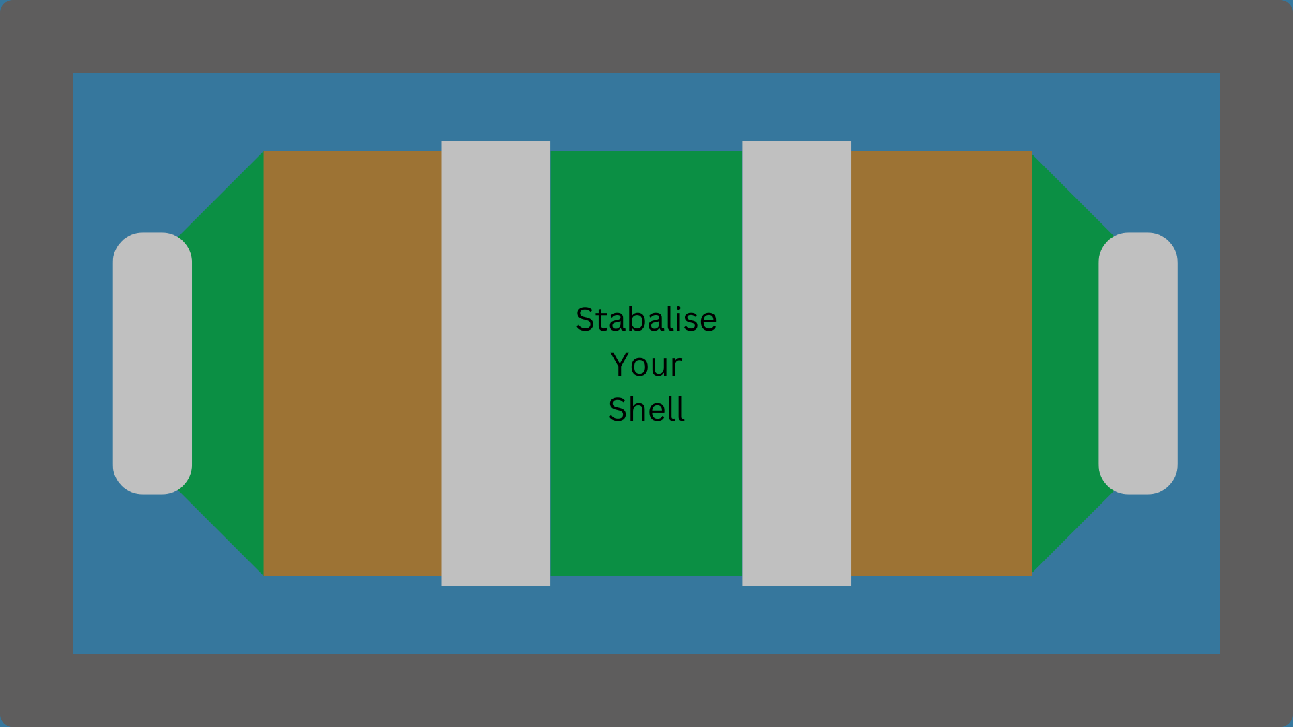

Slide 21
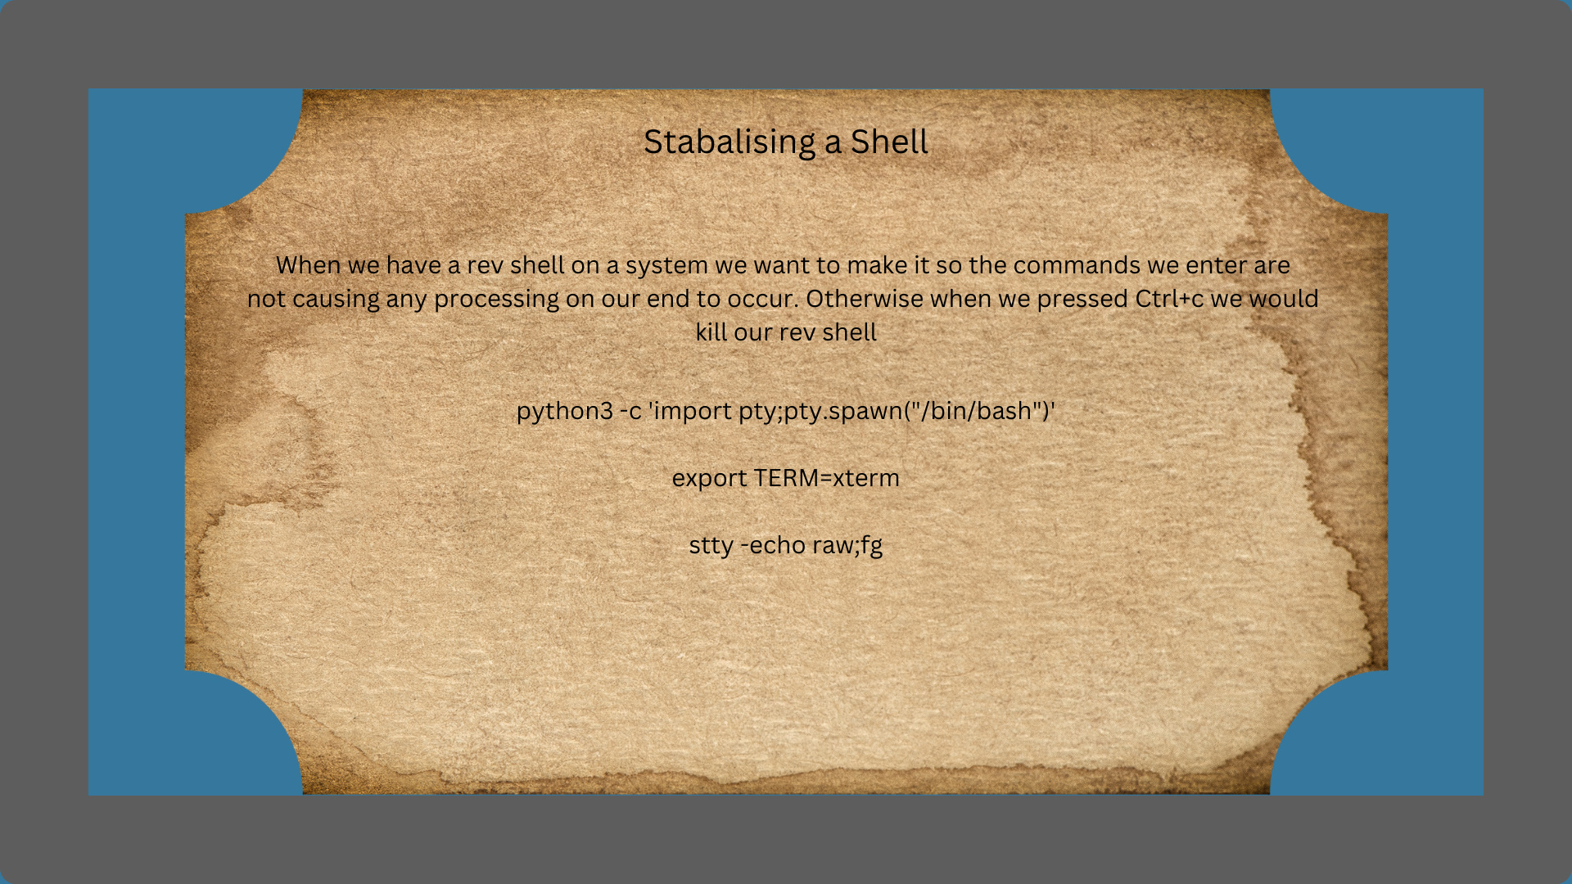
Notes:
This bit is for Jack only
Those of you who came to CTF club this week will have used some commands when creating a reverse shell in order to stabilize that shell
These commands are one of those things that you read about and then just remember because you will potentially end up using them all the time.
python3 -c 'import pty;pty.spawn("/bin/bash")' - spawns a shell using python3, this specific one spawns a bash shell
export TERM=xterm - This sets the terminal emulator for the shell, by default for distros like Ubuntu it is set to xterm. You can view what your terminal emulator is by running echo $TERM
You will then want to ctrl+z
stty -echo raw;fg - here we can set the options for the terminal device, -echo argument stops everything we enter being displayed back to us, raw argument then stops the processing from occurring on our end. fg brings the rev shell back to be the prominent operation

Slide 22
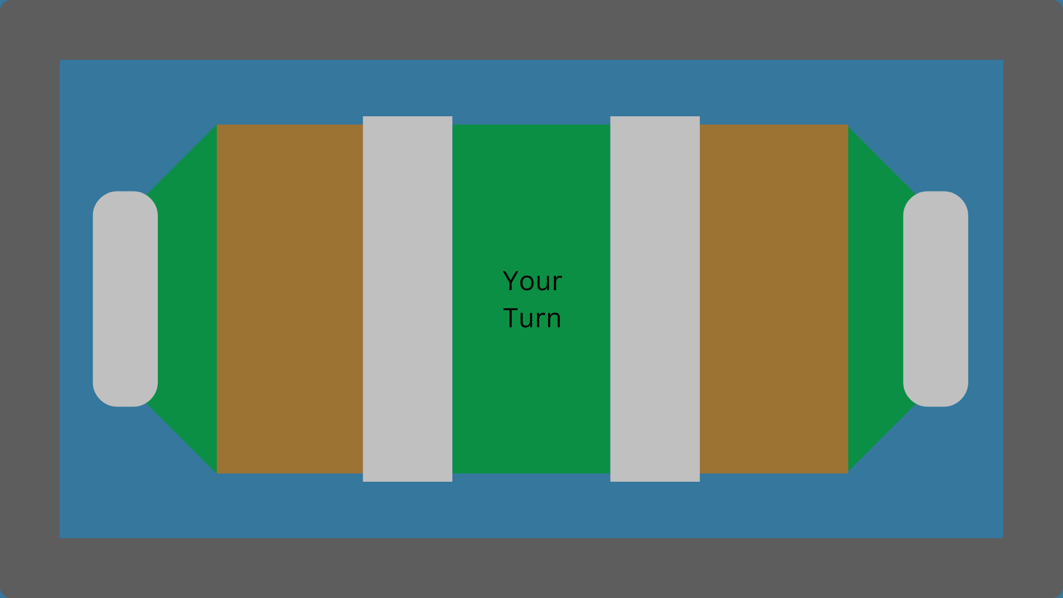

Slide 23
